Slide 1
PHASE 4: bYTECODE
- Ashutsh Sudhir Atre - Samson Yerraguntla - Chetan Jayadevaiah - Girish Rameshbabu

Slide 2
KEY FEATURES
SEARCH
LISTING
DETAILS
No User Login
No Need to Navigate as data gets directly available when you click on Search
Validation When No Data is Present in Textbox.

Slide 3
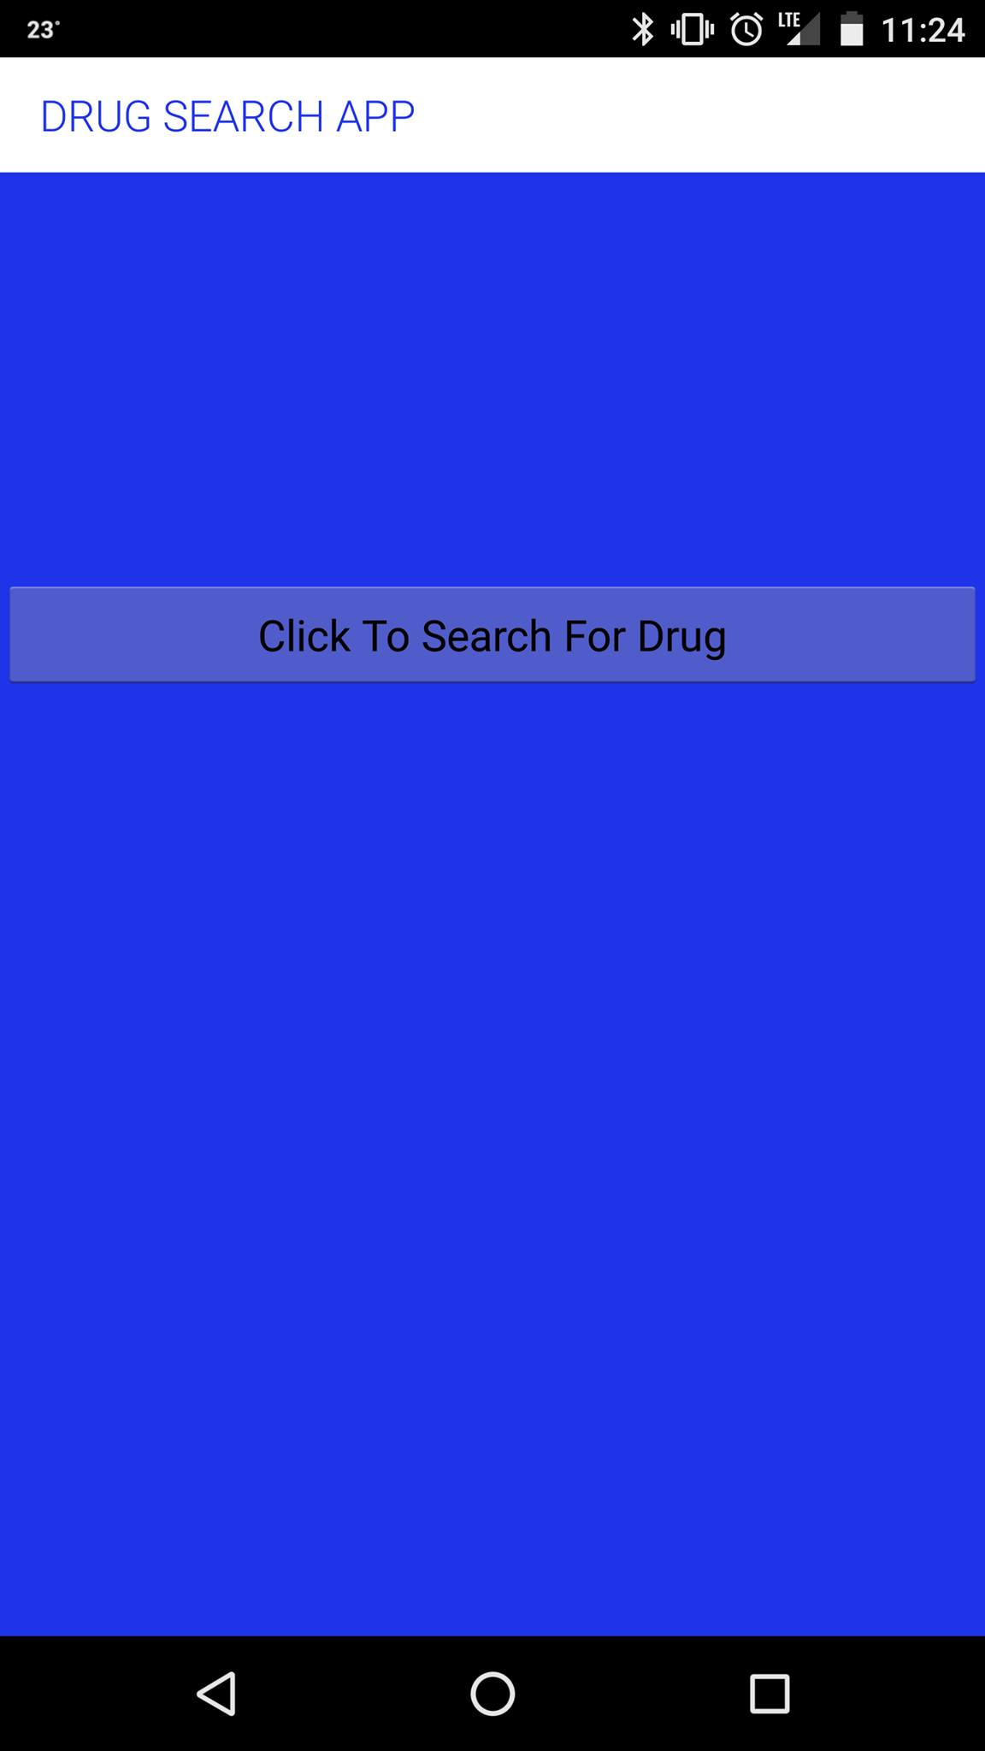
DRUG TO SEARCH

Slide 4
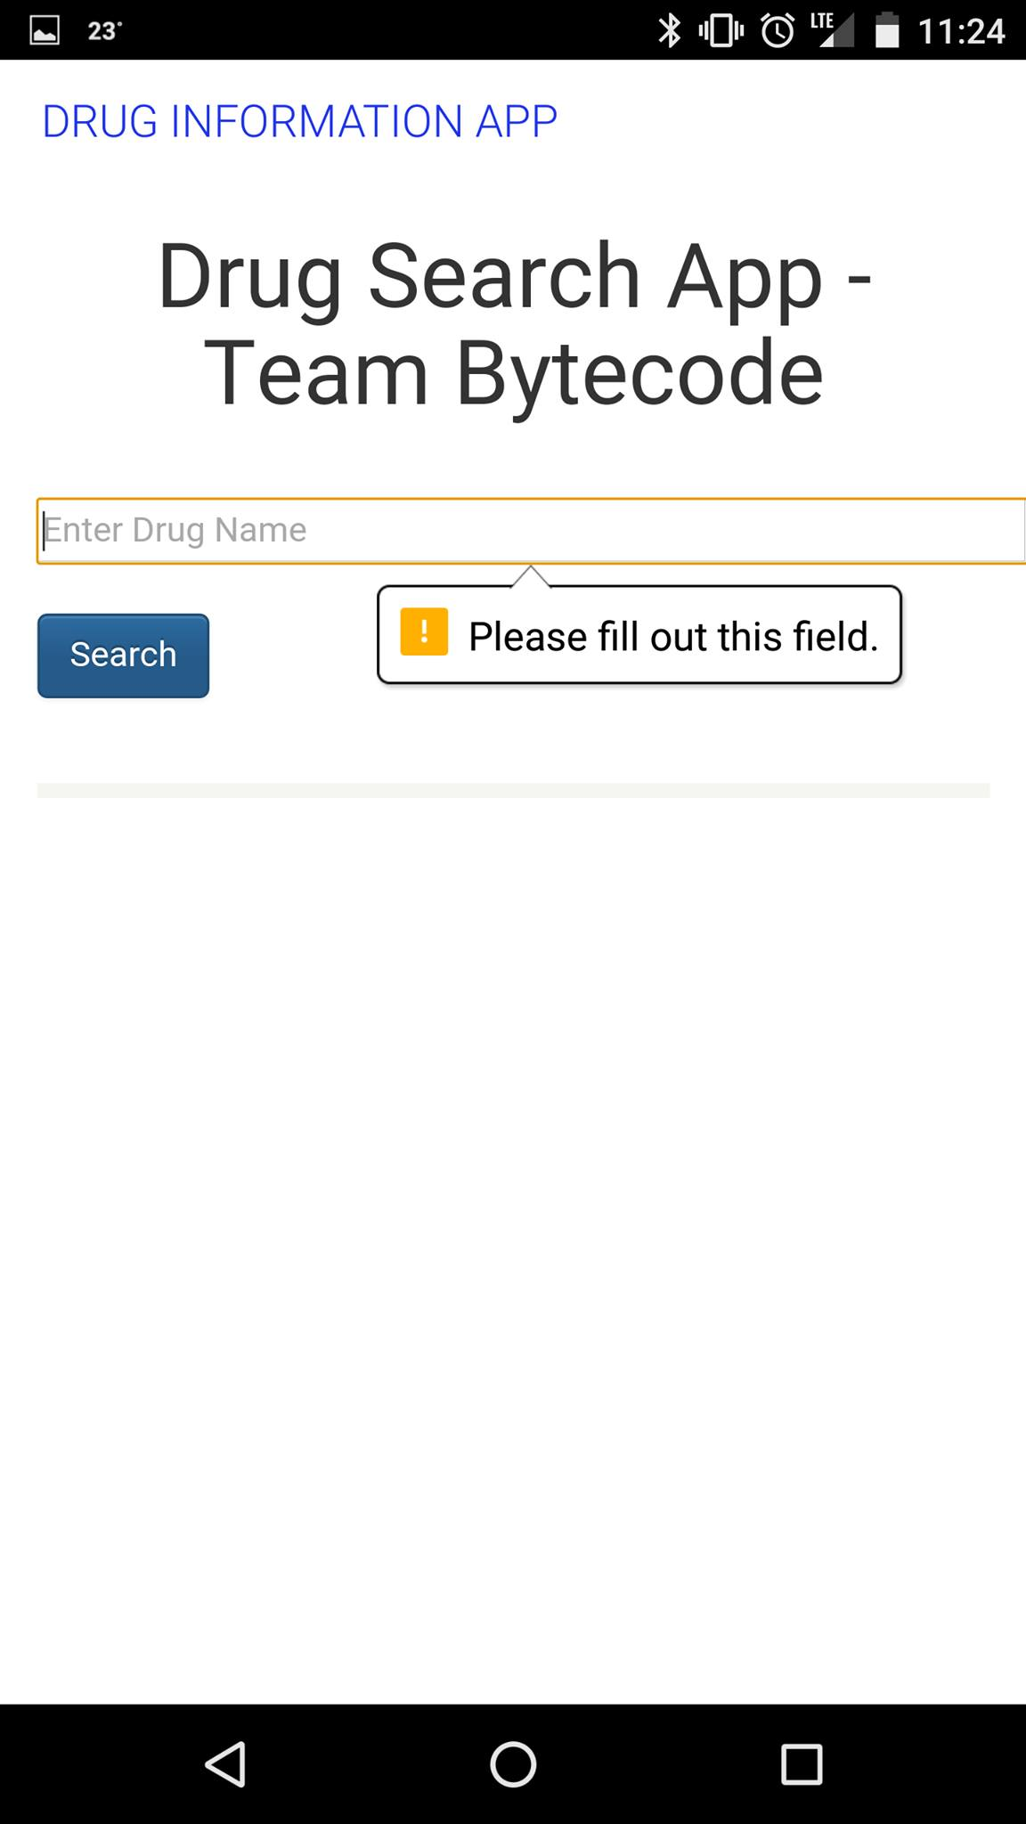
INPUT VALIDATION

Slide 5
Thank You

Slide 6
Thank You

